Slide 1
CSE- 271 Software Engineering
Lecture -6

Slide 2
Topics covered
User requirements
System requirements
Functional and non-functional requirements
The software requirements document

Slide 3
Software Requirements
The requirements for a system are
  The descriptions of the services provided by the system and
  The operational constraints
The requirement reflects
  The needs of the customer that help in solving the problem

Slide 4
Requirements Document
The software requirements document is a written statement of what the software will do
  Requirements document states what the software will do. It does not state how the software will do it
The main purpose of a requirements document is to serve as an agreement between the developers and the customers on what the application will do.

Slide 5
Requirement Engineering
The process of:
  finding out, analyzing, documenting and checking the services and the constraints is called “Requirement Engineering”.
The requirements are:
  The descriptions of the system services and constraints that are generated during the requirements engineering process.

Slide 6
Requirement Engineering
Requirements engineering process
  Feasibility study
    Establishing the need of the project
  Requirements elicitation and analysis
    Collection of requirements through observation, interviews
    Results in system models and prototypes
  Requirements specification
    Translating the gathered information into a document that define the set of requirements
    The document include user (abstract) requirements and detailed system requirements
  Requirements validation
    The activity checks the requirements for realism, consistency and correctness
    Errors in the requirements are discovered, modified for the correctness

Slide 7
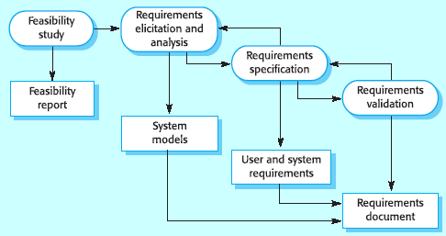
Requirement Engineering Process

Slide 8
Why Requirements?
System customers
  specify the requirements and read them to check they meet their needs
Project managers
  Use the requirements document to plan a bid for system and to plan the system development process
System engineers
  Use the requirements to understand the system being developed
System test engineers
  Use the requirements to develop validation tests for the system
System maintenance engineers
  Use the requirements to help understand the system

Slide 9
Types of requirements
User requirements
  Statements in natural language plus diagrams of the services the system provides and its operational constraints. Written for customers
System requirements
  A structured document setting out detailed descriptions of the system services. Written as a contract between client and contractor
Software specification
  A detailed software description which can serve as a basis for a design or implementation. Written for developers

Slide 10
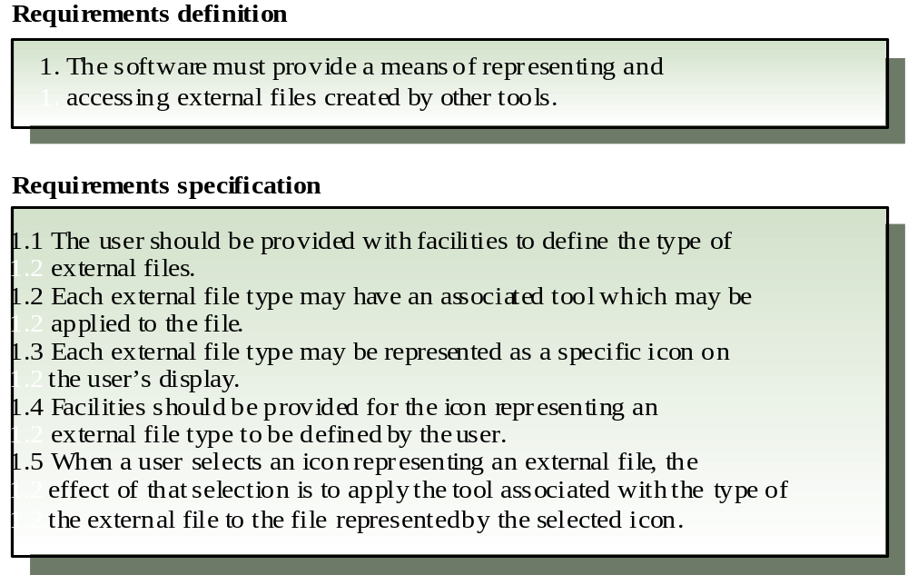
Definitions and specifications

Slide 11
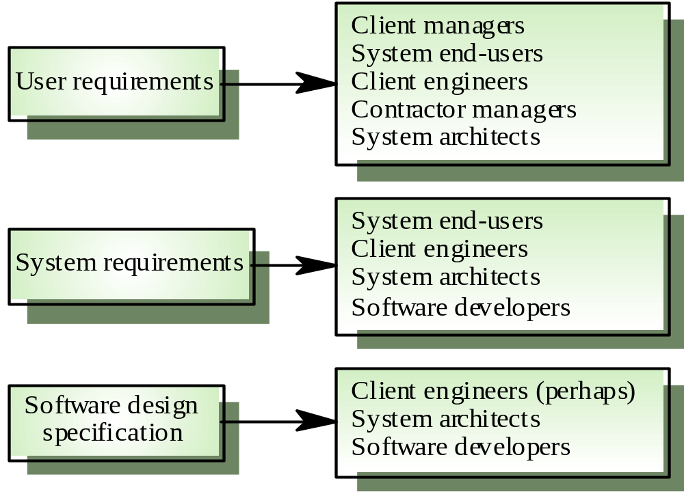
Requirements readers

Slide 12
Types of System requirements
Functional requirements
  Statements of services the system should provide, how the system should react to particular inputs and how the system should behave in particular situations.
Non-functional requirements
  constraints on the services or functions offered by the system such as timing constraints, constraints on the development process, standards, etc.
Domain requirements
  Requirements that come from the application domain of the system and that reflect characteristics of that domain

Slide 13
Functional requirements
Describe functionality or system services
Depend on the type of software, expected users and the type of system where the software is used
Functional user requirements may be high-level statements of what the system should do but functional system requirements should describe the system services in detail

Slide 14
Example
Lets consider a Library Management System with the following functional requirements:
  The system provides a single interface to a number of databases in different libraries
  Users can search for, download and print articles for personal study
  The system shall provide appropriate viewers for the users to read documents
  Every order shall be allocated a unique identifier

Slide 15
Requirements imprecision
Problems arise when requirements are not precisely stated
Ambiguous requirements may be interpreted in different ways by developers and users
Consider the term ‘appropriate viewers’
  User intention - special purpose viewer for each different document type
  Developer interpretation - Provide an apt text viewer that shows the contents of the document

Slide 16
Requirements completeness and consistency
In principle requirements should be both complete and consistent
Complete
  They should include descriptions of all facilities required
Consistent
  There should be no conflicts or contradictions in the descriptions of the system facilities
In practice, it is impossible to produce a complete and consistent requirements document

Slide 17
Non-functional requirements (NFR’s)
These define system properties and constraints
  e.g. reliability, response time and storage requirements
Constraints are I/O device capability, system representations, etc.
Process requirements may also be specified
  For e.g. mandating a particular CASE system, programming language or development method
Non-functional requirements may be more critical than functional requirements. If these are not met, the system is useless

Slide 18
Types of NFR’s
Product requirements
  Requirements which specify that the delivered product must behave in a particular way e.g. execution speed, reliability, etc.
Organisational requirements
  Requirements which are a consequence of organisational policies and procedures e.g. process standards used, implementation requirements, etc.
External requirements
  Requirements which arise from factors which are external to the system and its development process e.g. interoperability requirements, legislative requirements, etc.

Slide 19
Examples of NFR’s
Product requirement
  It shall be possible for all necessary communication between the APSE and the user to be expressed in the standard Ada character set
Organisational requirement
  The system development process and deliverable documents shall conform to the process and deliverables defined in XYZCo-SP-STAN-95
External requirement
  The system shall not disclose any personal information about customers apart from their name and reference number to the operators of the system

Slide 20
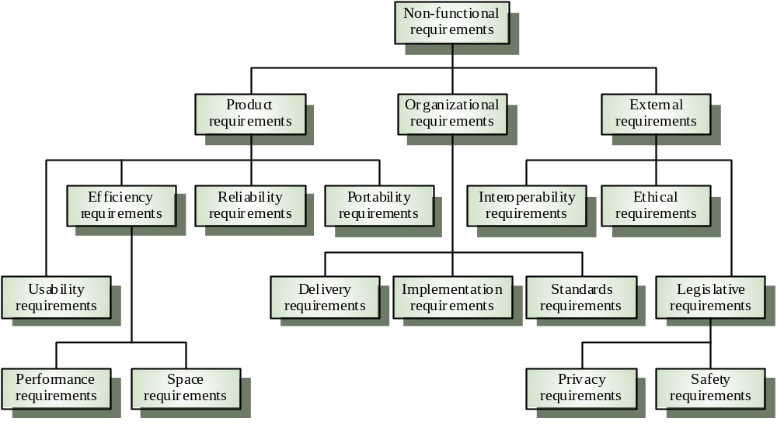
Non-functional requirement types

Slide 21
Example
Re-consider Library Management System. Following requirement is the example of non functional requirement
  The database may get crashed at any certain time due to virus or operating system failure. Therefore, it is required to take the database backup

Slide 22
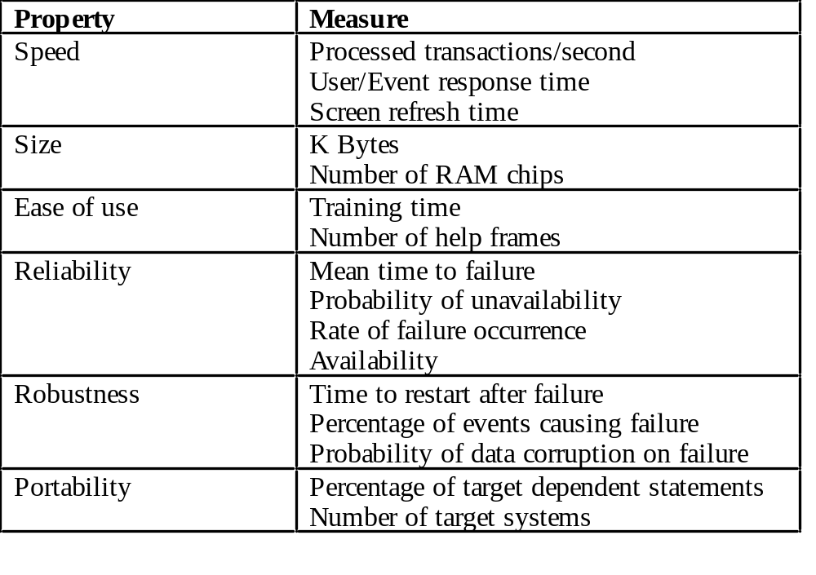
How to measure NFR’s?

Slide 23
Specifying the Requirements
Functional and nonfunctional requirements should be specified in such a way that they are understandable by system users who don’t have detailed technical knowledge.
These requirements are defined using natural language, tables and diagrams as these can be understood by all users.

Slide 24
Goals and requirements
Non-functional requirements may be very difficult to state precisely and imprecise requirements may be difficult to verify.
Goal
  A general intention of the user such as ease of use
Verifiable non-functional requirement
  A statement using some measure that can be objectively tested
Goals are helpful to developers as they convey the intentions of the system users

Slide 25
Examples
A system goal
  The system should be easy to use by experienced controllers and should be organised in such a way that user errors are minimised.
A verifiable non-functional requirement
  Experienced controllers shall be able to use all the system functions after a total of two hours training. After this training, the average number of errors made by experienced users shall not exceed two per day.

Slide 26
Requirements interaction
Conflicts between different non-functional requirements are common in complex systems
Spacecraft system
  To minimise weight, the number of separate chips in the system should be minimised
  To minimise power consumption, lower power chips should be used
  However, using low power chips may mean that more chips have to be used. Which is the most critical requirement?

Slide 27
Domain requirements
Derived from the application domain and describe system characteristics and features that reflect the domain
May be new functional requirements, constraints on existing requirements or define specific computations
If domain requirements are not satisfied, the system may be unworkable

Slide 28
Example of Domain Requirement - Train protection system
The deceleration of the train shall be computed as:
  D_{train} = D_{control} + D_{gradient}
where D_{gradient} = 9.81ms² * compensated gradient/alpha
the values of compensated gradient/alpha are known for different types of train.

Slide 29
Domain requirements problems
Understandability
  Requirements are expressed in the language of the application domain
  This is often not understood by software engineers developing the system
Implicitness
  Domain specialists understand the area so well that they do not think of making the domain requirements explicit

Slide 30
User requirements
Should describe functional and non-functional requirements so that they are understandable by system users who don’t have detailed technical knowledge
User requirements are defined using natural language, tables and diagrams

Slide 31
Requirements and design
In principle, requirements should state what the system should do and the design should describe how it does this
In practice, requirements and design are inseparable
  A system architecture may be designed to structure the requirements
  The system may inter-operate with other systems that generate design requirements
  The use of a specific design may be a domain requirement

Slide 32
The Requirements Document
The requirements document is the official statement of what is required of the system developers
Should include both a definition and a specification of requirements
It is NOT a design document.
As far as possible, it should set of WHAT the system should do rather than HOW it should do it

Slide 33
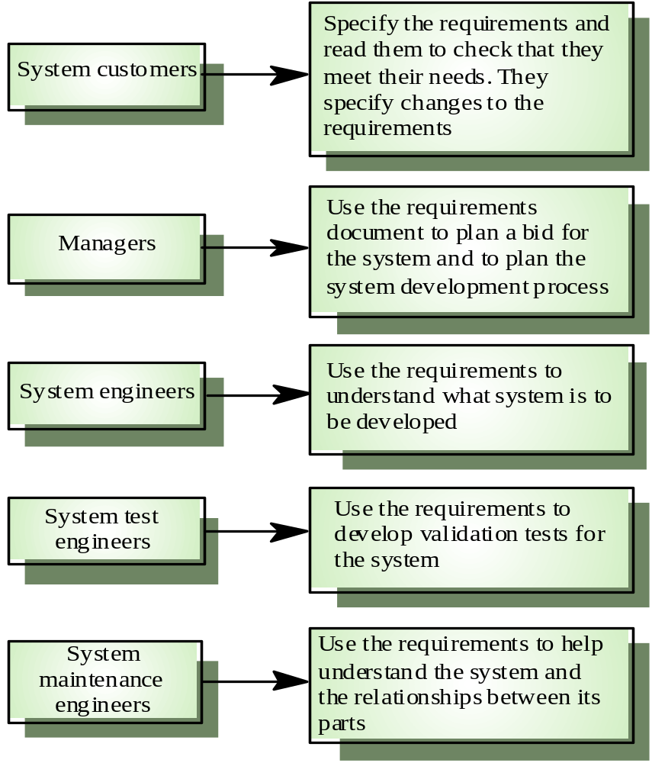
Users of a requirements document

Slide 34
Guidelines
While specifying or writing the requirements, following guidelines must be followed:
  Invent a standard format and use it for all requirements.
  Use language in a consistent way.
  Use shall for mandatory requirements, should for desirable requirements.
  Use text highlighting to identify key parts of the requirement.
  Avoid the use of computer jargons.

Slide 35
SRS
Software Requirement Specification
A document standardized by IEEE.
Used as a template to define detailed requirements of a software system.

Slide 36
Requirements document structure
Introduction
Glossary
User requirements definition
System architecture
System requirements specification
System models
System evolution
Appendices
Index

Slide 37
Assignment
Prepare a comprehensive SRS document for your project according to the SRS template.
Elicit the requirements by visiting the client organization. (Attach questionnaire forms used to gather requirements)
Mention the resource person in the client organization.
Deadline for submitting SRS Document : 6th Dec 2010

